Slide 1
Making Today’s Internet Faster
(Automatic Transition To Peer-to-Peer Download)
Roger Pack
MS Thesis
Notes:
Formal
use “automatic swarming” or I
25 minutes or so
Nothing in hands

Slide 2
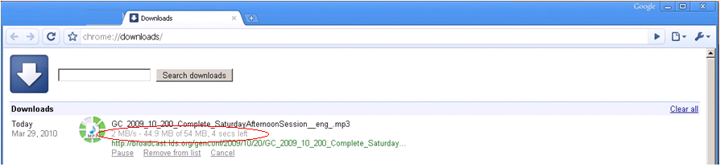
Fast download

Slide 3
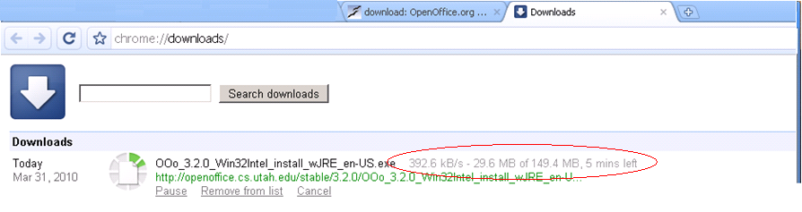
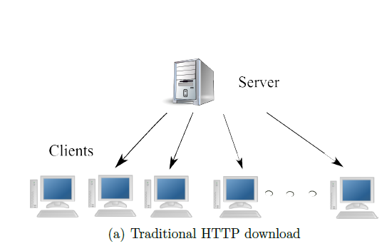
Slow downloads
Relative frustration
Wasted bandwidth
Server under-provisioned
Internet congestion
Flash crowd

Slide 4
Your options
Wait
Download manager
Parallel
Add a local caching proxy

Slide 5

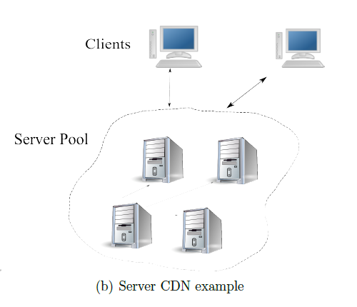
Server options
Buy more bandwidth
Rent a CDN
Expensive
Overloaded
Turn to P2P

Slide 6

P2P
BitTorrent
Create + host .Torrent File
Run a tracker
Peers download and share blocks (efficiently)
“When I created BitTorrent in 2001, my mission was to solve the problem every website has when distributing large, popular files” – Bram Cohen

Slide 7
BitTorrent Downsides
Server side
Per file
Extra maintenance
Have to provide traditional anyway
Lack of clients
Stigma
Optimized for large files, long downloads
Unknown demand

Slide 8
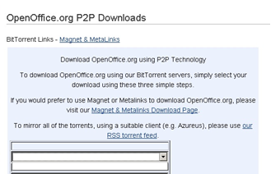
BitTorrent Downsides
Client side
Extra setup/time per file
Manual
Small files
Non integrated (browsing)
Technical expertise
Often slower than client-server
Not enough seeds
Not available
Notes:
Viz: The general problem is that when downloading typical files from the Internet, BitTorrent cannot come to your aid.
Not HTTP optimized (web seeds) typically
Also warmup phase

Slide 9
Other Related Work
Client-side protocols
Squirrel
Share local browser caches
No transition
Extra hop
No swarming
Not built for Internet at large
Server-side protocols
Backslash
Limited by servers’ bandwidth
Cooperative protocols
BitTorrent

Slide 10
Automatic Swarming
Automatic Transition to Peer-to-Peer download
Monitor download
Automatically switch if it becomes slow

Slide 11
Automatic Swarming -- Goals
Overcome deficiencies of BitTorrent
Work for any file on any server without configuration
Easy for client use
No extra hardware
Work for small files
Non intrusive
Legal
Wouldn’t it be great if this was built into Internet Explorer and Firefox?
Make swarming more adoptable
All downloads
Notes:
Something like this, should it exist, would be quite useful if it were built into IE

Slide 12
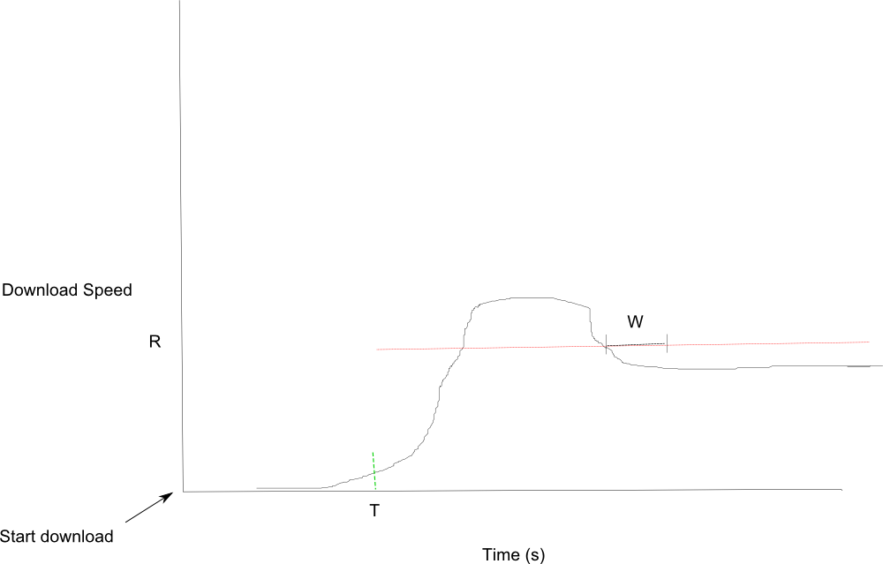
Automatic Swarming – Monitoring Downloads

Slide 13
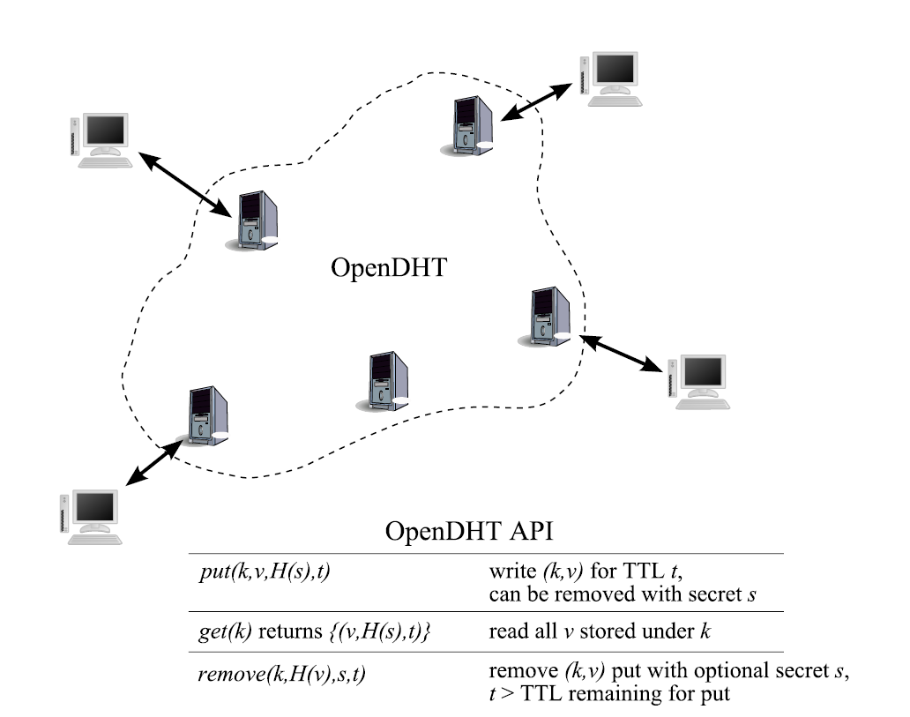
P2P Delivery – Finding Peers
OpenDHT
Scalable, distributed lookup
Runs as service

Slide 14
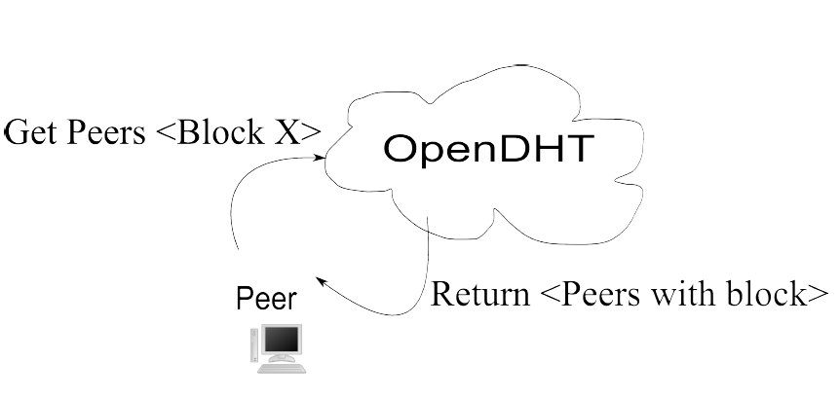
P2P Delivery
Query for peers
Per block
Poll on none found
Download from the origin while polling
When find live peer, download
Last block

Slide 15
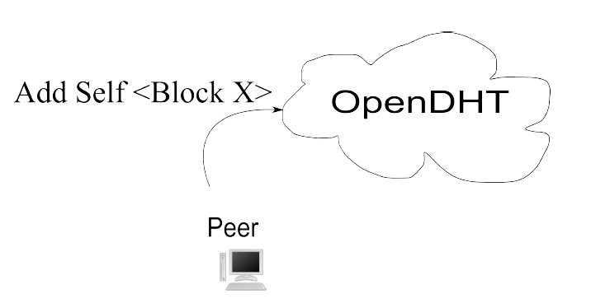
P2P Sharing
Linger
Remove

Slide 16
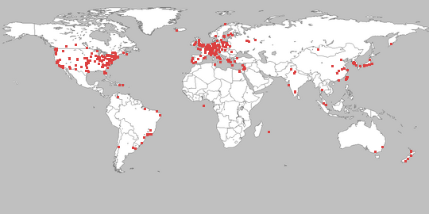
Methodology
PlanetLab
Private OpenDHT

Slide 17

Methodology
Start multiple clients over time
BYU server
256 KB/s
Run until finish
Repeat each run 3x
Calculate percentiles
download times
DHT response times
causes for transitioning to P2P

Slide 18
Scalability Test
Load
File size: 100 KB
Vary client load from 1 to 20 clients/second
100 seconds per test
Both Client-Server and Automatic Swarming
Automatic Swarming Parameters
R 128 KB/second
W 2 seconds
T 1 second
Linger 60 seconds
Notes:
Note that a semi-popular website might serve half a
million hits a day, which averages to 6 per second, so our limit of 20 per second is similar, if
you take into consideration spikes in load

Slide 19
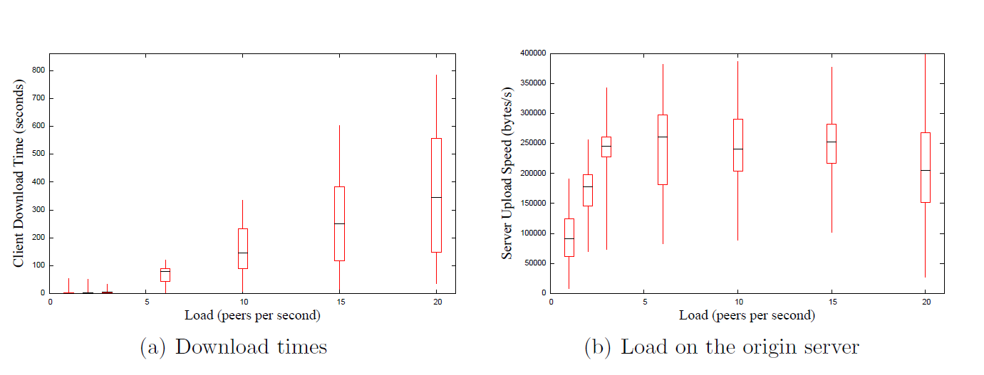
Performance – Client-Server

Slide 20
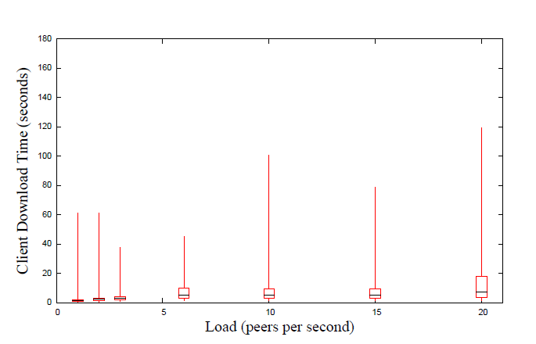
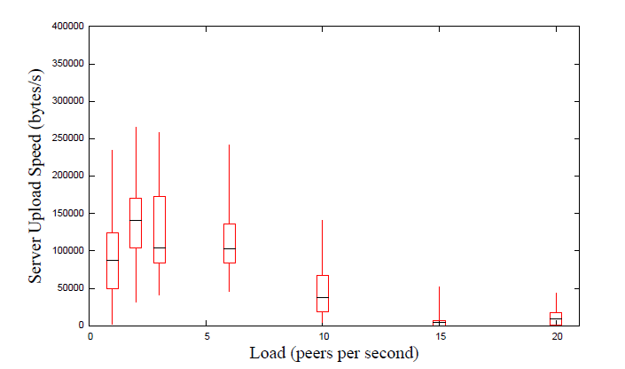
Performance – Automatic Swarming
At 20 Peers/second
DHT median latency of 5.2 seconds

Slide 21
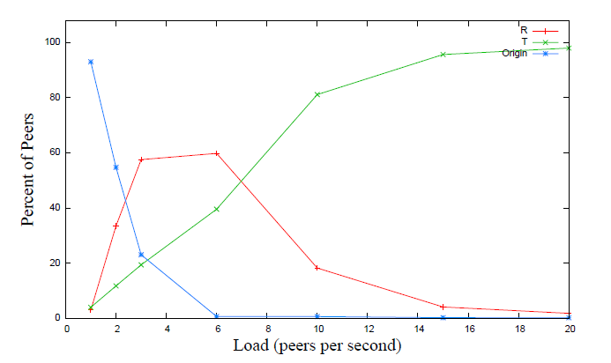
Automatic Swarming – Transition Causes
T – first byte timeout
R – server speed too low
Origin – did not transition to P2P
20 Peers/Second
99.5% transition because of T

Slide 22
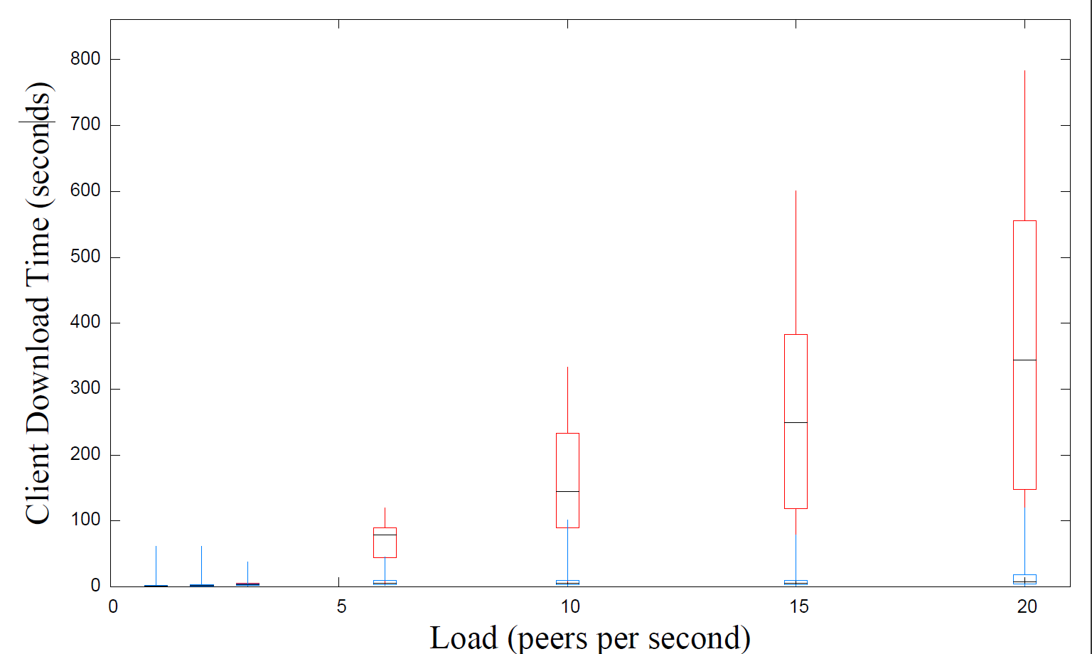
Comparison
30x faster

Slide 23
Individual Parameter Tests
Static Load
File size: 100 KB
1000 peers
15 peers/s
Linger 20 s
Vary one parameter
T: 0 - 10 s
R: 32 KB/s - 1 MB/s
W: 0.1 - 10 s
Peer concurrency count 1-50
Reasonable defaults
Notes:
Could avoid this slide altogether, theoretically, but we’ll do it for here.
Defaults were: b 5
R 128 KB/s
T 1 (?)
W 2 (?)

Slide 24
Optimal Discovered Values
T: 0.75 s
W: 0.25 s
Small
R: 160 KB/s
Block size: 32 KB
Parallelize
Peer concurrency count: 16 +

Slide 25
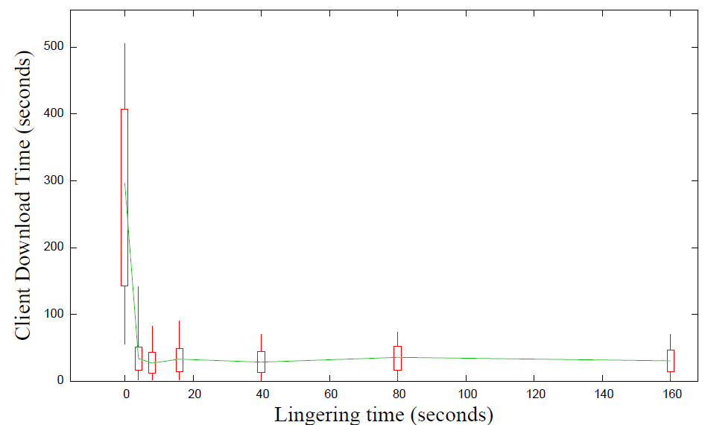
Linger Time
4 seconds best
Notes:
All I did was “add_median_line” = true
skippable

Slide 26
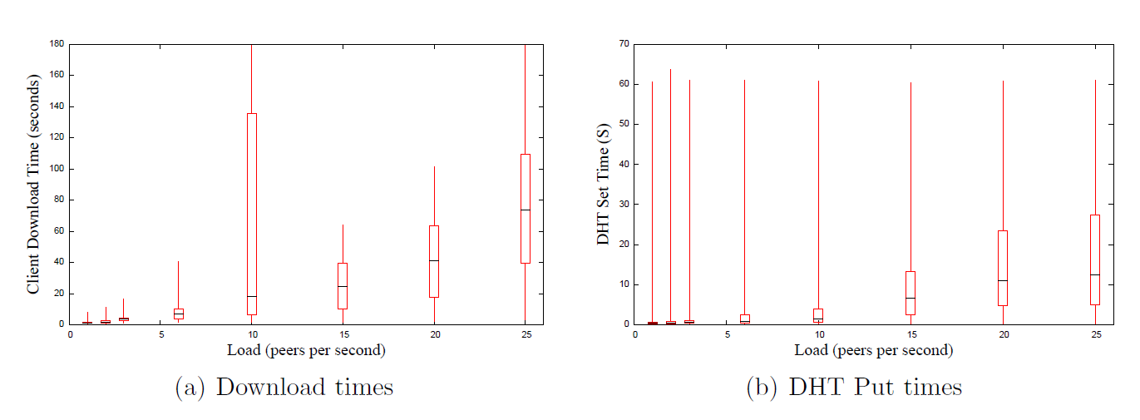
Full Web Page
Simulate full web page
1 100 KB file, 10 10K files
11 x as much load on the DHT
Linger time 20 seconds

Slide 27
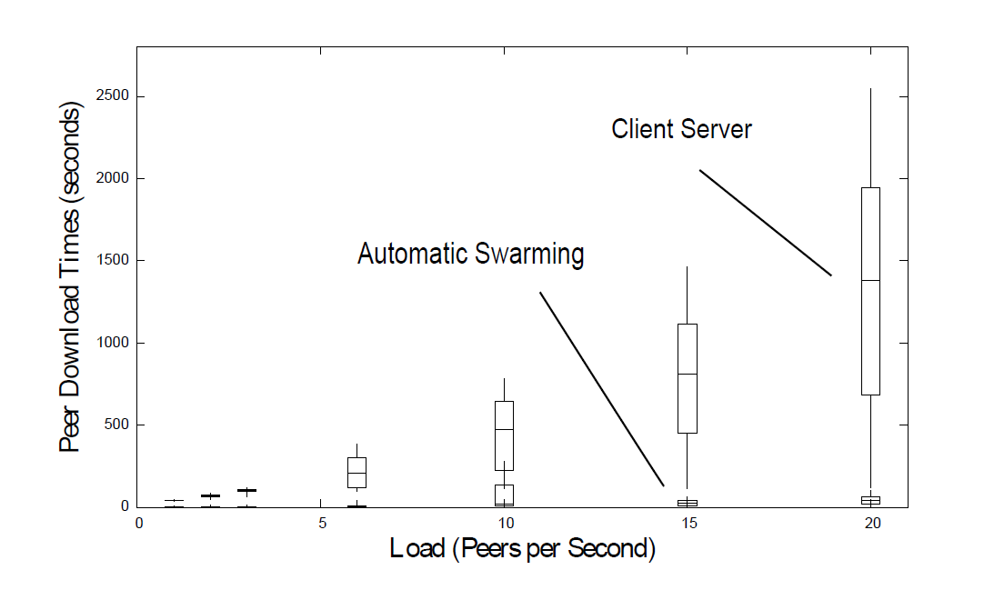
Multiple Files Versus Client-Server
20x faster

Slide 28
With Large Files
30MB File
100 Peers
100 Seconds

Slide 29
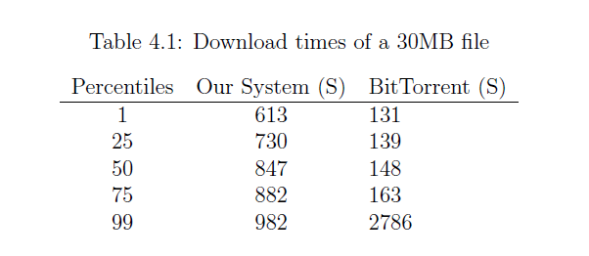
With Large Files
BitTorrent Large File Optimizations
Seeds limit outgoing connections
Favors stronger connections
Dedicated tracker
Rarest Block First
Notes:
“Ours doesn’t perform as well as BT for large files”

Slide 30
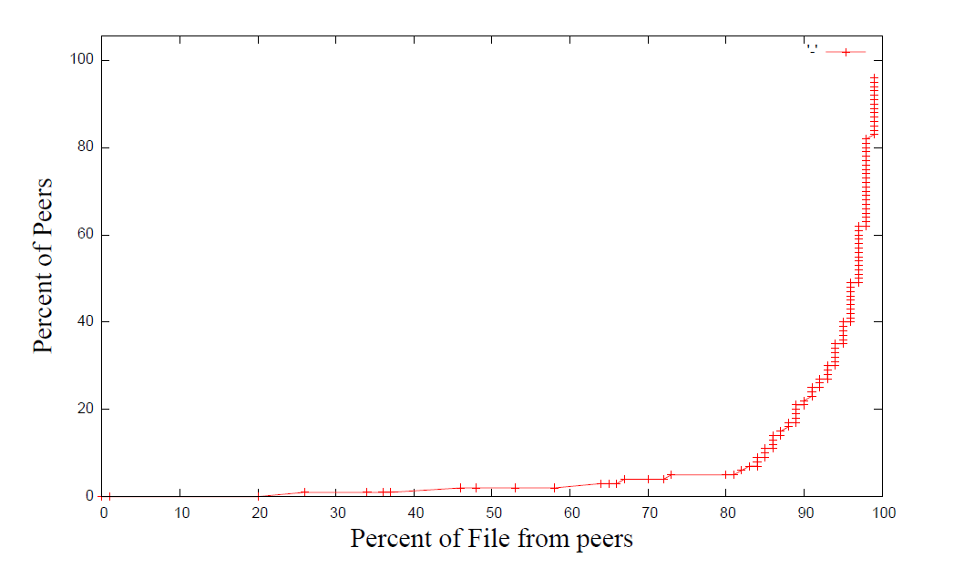
With Large Files
Fast, once gets started
Notes:
Skippable

Slide 31
Conclusion
Feasible transition to Peer-to-Peer download
30x as fast for small files
20x as fast for web pages
Reduces load on the server
Make swarming more usable/adoptable

Slide 32
Automatic Swarming -- Goals
Work for any file on any server without configuration
Easy for user
No extra dedicated hardware
Work for small files
Non intrusive
Today’s Internet: Faster.

Slide 33
Future Work
Improve DHT performance
Improve Automatic Swarming for large files
General performance tuning and dynamic selection of parameters
Better use of the DHT
Staleness
BitTorrent features
Validate Integrity
Incentives

Slide 34
Questions?

